Slide 1
Confidentiality Using Symmetric Encryption

Slide 2
Contents
Placement of Encryption Function
Traffic Confidentiality
Key Distribution
Random Number Generation

Slide 3
Placement of Encryption Function
If encryption is to be used to counter attacks on confidentiality, we need to decide what to encrypt and where encryption function should be located.
This section examines
  the potential locations of security attacks
  look at the major approaches to encryption placement
    link encryption
    end to end encryption
Notes:
기밀성에 대한 설명 추가

Slide 4
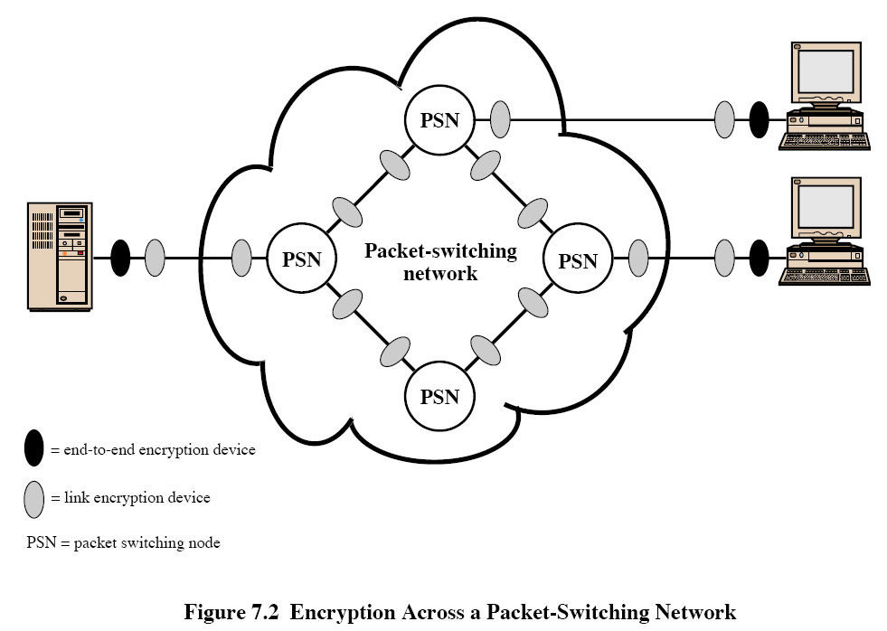
Link Encryption
Link encryption
  Each switch or node is equipped with an encryption device.
  The traffic between every two nodes is encrypted by a unique key.

Slide 5
Link Encryption
What part of each packet should be encrypted?
  A packet consists of a header and user data.
  The entire packet (header + data) is encrypted.
Disadvantages
  The message is decrypted at each node.
  It requires a lot of encryption devices.
    An encryption device for a node.
  It requires a lot of keys.
    A unique key for a link.

Slide 6
Link versus End-to-End Encryption
End-to-end encryption
  The source and destination hosts encrypt the data.
  The source and destination share a key.

Slide 7
End-to-End Encryption
End-to-end encryption
  It is secure against attacks on nodes.
  It provides a degree of source authentication.
    Because only the source host can encrypt the data.
Link encryption provides host authentication.

Slide 8
End-to-End Encryption
What part of each packet should be encrypted?
  A packet consists of a header and user data.
  Encrypting the entire packet?
    Impossible. The encrypted packet cannot be routed.
  Encrypting only the user data?
    Possible. But the traffic pattern is revealed.

Slide 9
Link versus End-to-End Encryption
To achieve greater security, both link and end-to-end encryption are needed!
  The source host encrypts the user data portion of a packet using an end-to-end encryption key.
  Then, the entire packet is encrypted using a link encryption key.
  As the packet traverse the network, each switch decrypts the entire packet, using a link encryption key to read the header, and then encrypts the entire packet for sending it out on the next link.

Slide 10

Logical Placement of End-to-End Encryption Function
The link encryption: The physical or link layers.
The end-to-end encryption: The network or higher layers.
Application
Presentation
Session
Transport
Network
Data Link (MAC)
Physical
OSI 7Layer
End-to-End Encryption
Link Encryption

Slide 11
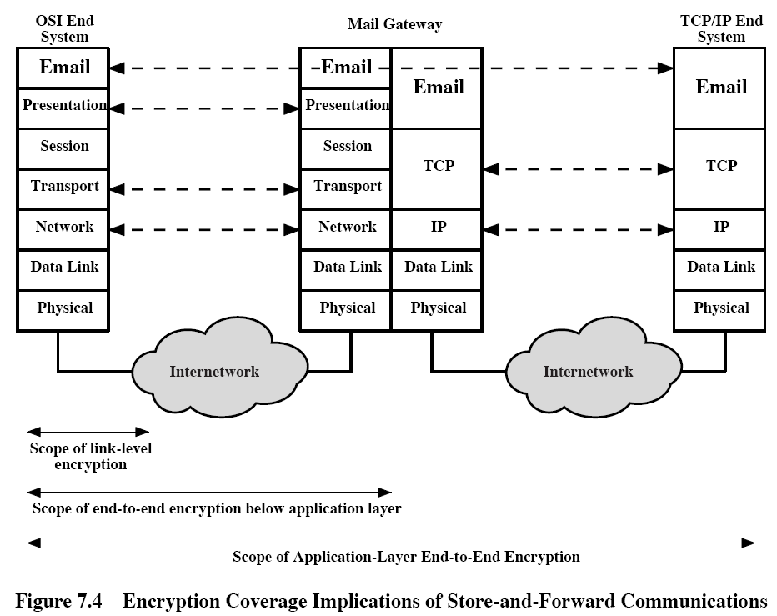
Logical Placement of
End-to-End Encryption Function
Scope of end-to-end encryption

Slide 12
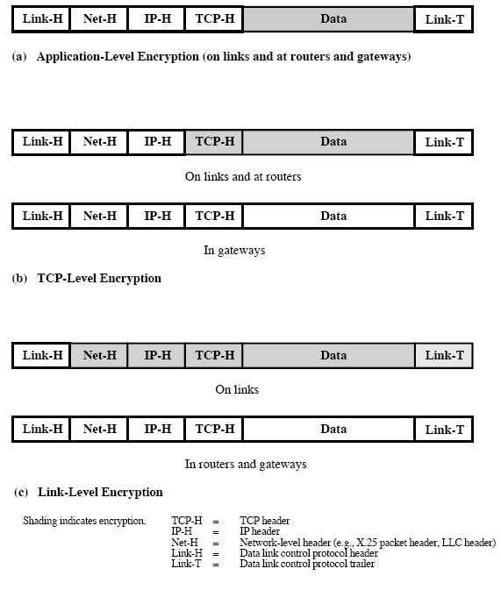
Logical Placement of
End-to-End Encryption Function
Relationship between encryption and protocol levels

Slide 13
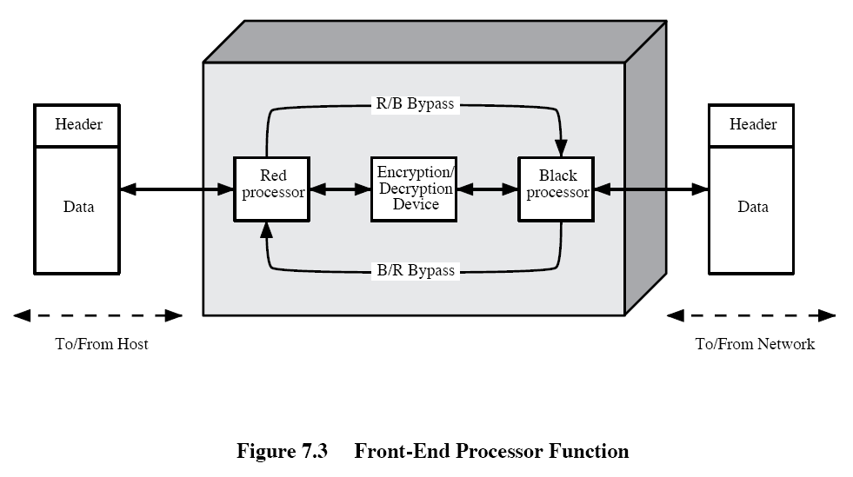
Logical Placement of
End-to-End Encryption Function
Front-end processor function
  If all user processes and applications in a host use the same encryption scheme with the same key, it might be desirable to off-load the encryption function to front-end processors.

Slide 14
Logical Placement of
End-to-End Encryption Function
Front-end processor function
  The user data is encrypted.
  The packet header bypasses the encryption.

Slide 15
Contents
Placement of Encryption Function
Traffic Confidentiality
Key Distribution
Random Number Generation

Slide 16
Traffic Confidentiality
Information that can be derived from a traffic analysis
  Identities of partners
  How frequently the partners are communicating.
  Message pattern, message length, or quantity of messages that suggest important information is being exchanged.
  The events that correlate with special conversations between particular partners.

Slide 17
Traffic Confidentiality
Another concern is a covert channel.
  Covert channel
    A means of communication unintended by the designers.
    By using the covert channel,
    a person can send a message to another person without detection.
    A covert channel can be created by using traffic analysis.

Slide 18
Traffic Confidentiality
Covert channel example
  A wish to send a byte to B without detection.
  A sends 8 legitimate messages to C.
  B analyzes the traffic from A.
    If the message is longer than 100 bytes, it is 1 bit.
    Otherwise, it is 0 bit.
  In this way, B can receive the byte from A without detection.

Slide 19
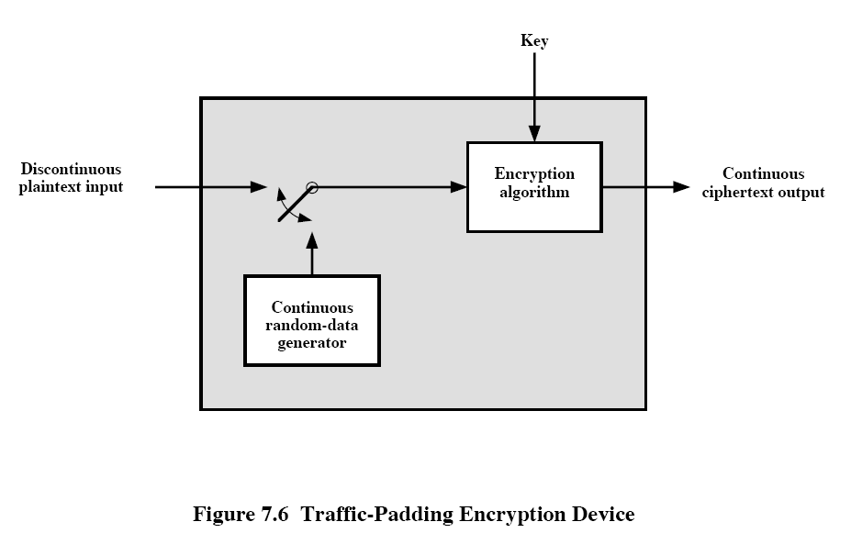
Traffic Confidentiality
Countermeasures on link encryption
  When plaintext is available, it is encrypted and transmitted.
  When plaintext is not present, random data are encrypted and transmitted.
  This make it impossible to distinguish between true data flow and padding.

Slide 20
Traffic Confidentiality
Countermeasures on end-to-end encryption
  Since header information is not encrypted in end-to-end encryption, traffic confidentiality is hard to achieve.
  A restricted padding: padding out data units to a uniform length. In addition, null messages can be inserted randomly into the stream.
  These tactics
    deny an opponent knowledge about the amount of data exchanged between end users and
    obscure the underlying traffic pattern.

Slide 21
Contents
Placement of Encryption Function
Traffic Confidentiality
Key Distribution
Random Number Generation

Slide 22
Key Distribution-contents
Different Techniques of key distribution
How to distribute key between two users
Different types of keys
Key distribution scenario
Hierarchical Key control
Session Key Life Time
Transparent Key control Scheme
Decentralized Key control

Slide 23
Key Distribution
Introduction
  For symmetric encryption to work, the two parties must share the same key.
  Frequent key changes are usually desirable to limit the amount of data compromised if an attacker learns the key.
  Therefore, the strength of any cryptographic system rests with the key distribution technique.

Slide 24
Key Distribution
Key distribution techniques
  1. A can select a key and physically deliver it to B.
  2. A third party can select the key and physically deliver it to A and B.
  3. If A and B have previously and recently used a key, one party can transmit the new key to the other encrypted using the old key.
  4. If A and B each has an encrypted connection to a third party C, C can deliver a key on the encrypted links to A and B.

Slide 25
Key Distribution
Key distribution options 1 and 2.
  Manual delivery
  For link encryptions: OK
    Each node exchanges data with only its neighboring nodes.
  For end-to-end encryptions: Awkward
    Network or IP-level encryption (#N host)
      A distributed system with N nodes : N(N-1)/2 keys are needed.
    Application level encryption
      A key is needed for every pair of users or processes that require communication.

Slide 26
Key Distribution
Key distribution option 3
  3. If A and B have previously and recently used a key, one party can transmit the new key to the other, encrypted using the old key.
  It can be appropriate for link and end-to-end encryption.
  BUT if an attacker ever succeeds in gaining access to one key, then all subsequent keys will be revealed.
  Furthermore, the initial distribution of N(N – 1)/2 keys is awkward.

Slide 27
Key Distribution
Key distribution option 4
  4. If A and B each has an encrypted connection to a third party C, C can deliver a key on the encrypted links to A and B.
  For end-to-end encryption, some variation on it has been widely adopted.
  Each user must share a unique key with the Key distribution center (KDC) for purposes of key distribution. (N keys in total.)

Slide 28
Key Distribution-types of Keys
Session key
  Temporary key
  Used for the duration of a logical connection between A and B.
  Generated by the key distribution center.
  [N(N – 1)] / 2 keys are needed at any one time.
Master key
  Session keys are encrypted using a master key.
  N master keys are required.
  Physically delivered.

Slide 29
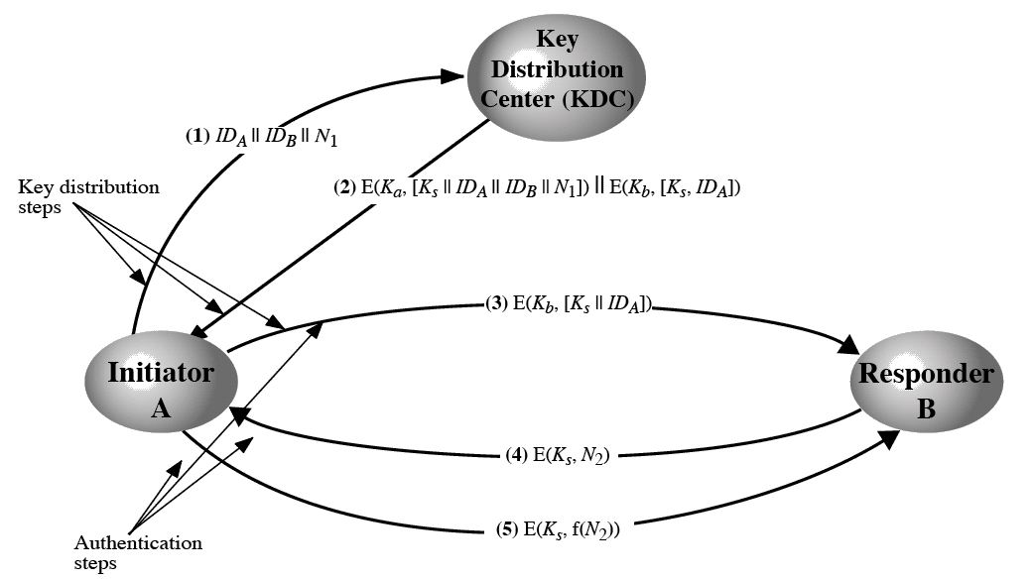
Key Distribution Scenario
User A wishes to establish a logical connection with B.
  A and B share a master key K_{a} and K_{b} with the KDC, respectively.
Notes:
각각 명칭에 대해 설명을 앞에 첨부

Slide 30
Key Distribution Scenario
A Key Distribution Scenario
  (1) ID_{A}|| ID_{B}||N₁
    A issues a request to the KDC for a session key to connect to B.
    The message includes
      The identity of A and B
      A unique identifier N_{1,}(nonce) for this transaction.
    The nonce may be a timestamp, a counter, or a random number.
      It must differ with other request’s nonce.
      It should be difficult for an opponent to guess the nonce to prevent masquerade.
      Thus, a random number is a good choice for a nonce.

Slide 31
Key Distribution Scenario
A Key Distribution Scenario
  (2) E(K_{a},[K_{s}||ID_{A}||ID_{B}||N₁]) || E(K_{b}, [K_{s}||ID_{A}])
    The KDC responds with a message encrypted using K_{a}.
    A is the only one who can receive the message and A know that it originated at the KDC.
    The message includes two items for A.
      The one-time session key K_{s}
      The original request message ID_{A}||ID_{B}||N₁
    The message includes two items for B.
      The one-time session key K_{s}
      An identifier of A, ID_{A}

Slide 32
Key Distribution Scenario
A Key Distribution Scenario
  (3) E (K_{b}, [K_{s},ID_{A}])
    A stores the session key and forward E (K_{b}, [K_{s},ID_{A}]) to B.
      It is encrypted by K_{b} so it is protected from eavesdropping.
      Now, B knows the session key K_{s}, knows the other party is A, and knows that the information originated at the KDC. (because it is encrypted using K_{b})

Slide 33
Key Distribution Scenario
A Key Distribution Scenario
  (4) E (K_{s}, N₂)
    B sends a nonce N₂ to A encrypted with the new session key K_{s}.
  (5) E (K_{s}, f(N₂))
    A responds with f(N₂).
    f(N₂) an arbitrary function that transforming N₂
      For example, f(N₂) = N₂ + 1.
  Steps (4) and (5) are to confirm that both A and B have the correct session key.

Slide 34
Hierarchical Key Control
Hierarchical Key Control
  Instead of using one KDC, several KDCs can be used in a hierarchy.
  A local KDC is responsible for a local domain, such as a single LAN or a single building.
  For communication among entities within a local domain, the local KDC is responsible for key distribution.
Local
KDC
Local
KDC
Domain 1
Domain 2

Slide 35
Hierarchical Key Control
Hierarchical Key Control
  If two entities in different domains desire a shared key, then corresponding local KDCs can communicate through a global KDC.
  In this case, any one of the three KDCs can select the key.
Global
KDC
Local
KDC
Local
KDC
Domain 1
Domain 2

Slide 36
Hierarchical Key Control
Hierarchical Key Control
  A hierarchical scheme minimizes the effort involved in master key distribution because most master keys are those shared by a local KDC with its local entities.
  Furthermore, such a scheme limits the damage of a faulty or subverted KDC to its local area only.
Global
KDC
Local
KDC
Local
KDC
Domain 1
Domain 2

Slide 37
Session Key Lifetime
Session key lifetime: How often session keys are changed.
The more often the keys are changed, the more secure they are.
  Because the opponent has less ciphertext for any given session key.
The less often the keys are changed, the more efficient they are.
  Because the key distribution delays data transmission.
A security manager have to balance these competing considerations in determining the session key lifetime.

Slide 38
Session Key Lifetime
Session key lifetime
  Connection-oriented protocol
    Normally, a session key per connection.
    However, the session is too long, periodically changing the session key is recommendable.
  Connectionless protocol
    A session key for a fixed period.

Slide 39
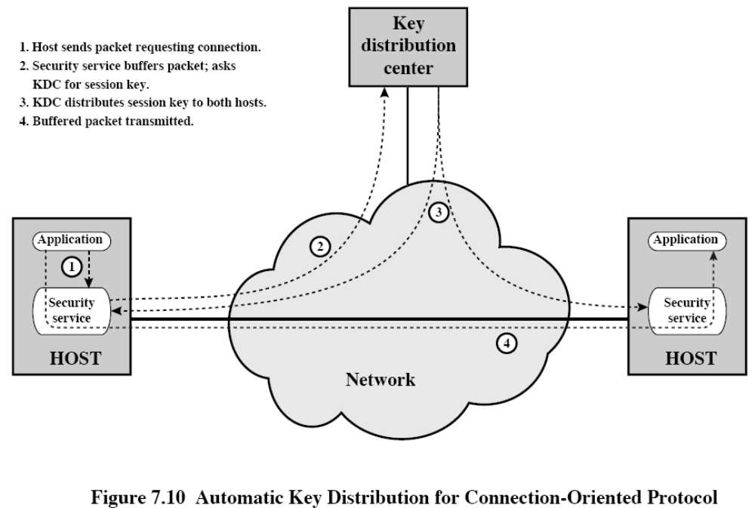
A Transparent Key Control Scheme
Session security module (SSM)
  On behalf of the host or terminal, the SSM obtains session keys and performs end-to-end encryption.
Notes:
투명성의 정의를 이야기 해줌 미리

Slide 40
A Transparent Key Control Scheme
The approach assumes that communication makes use of a connection-oriented end-to-end protocol.
The SSM does the security-related work and is transparent to the hosts.
Notes:
투명성의 정의를 이야기 해줌 미리

Slide 41
Decentralized key Control
The use of a KDC imposes the requirement that the KDC be trusted and be protected from subversion.
This requirement can be avoided if distribution is fully decentralized.
  Full decentralization is not practical for larger networks.
  But, it may be useful within a local context.

Slide 42
Decentralized key Control
Decentralized key Control
  When KDC is used, the KDC should be trusted and protected from subversion.
  But this requirement can be avoided if key distribution is fully decentralization.
  A decentralized approach requires that each end system be able to communicate in a secure manner with all potential partner for purpose of session key distribution.
  n(n-1)/2 master keys are needed for a configuration with n end systems.
  Each node must maintain (n-1) master keys.

Slide 43
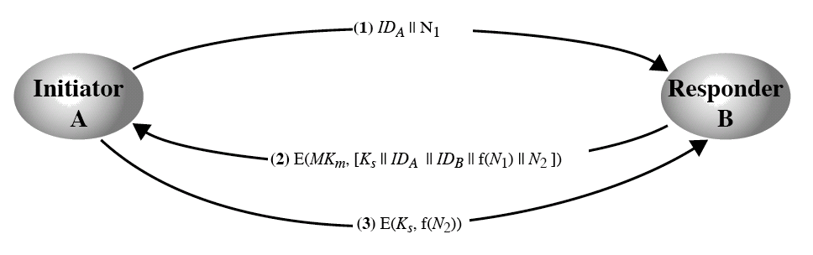
Decentralized key Control
Decentralized key Control

Slide 44
Controlling Key Usage
The different types of session keys
  Data-encrypting key
  PIN-encrypting key
  File-encrypting key
How to attach type information to the session key?
Notes:
여기!!!

Slide 45
Controlling Key Usage
Associate a tag with each key.
Makes use of the extra 8 parity bits in each 64-bit DES key.
  One bit indicates whether the key is a session key or a master key.
  One bit indicates whether the key can be used for encryption.
  One bit indicates whether the key can be used for decryption.
  The remaining bits are spares for future use.

Slide 46
Controlling Key Usage
Drawback
  The tag length is limited to 8 bit, limiting its flexibility and functionality.
  The tag information is used only at the point of decryption because the tag is not transmitted in clear form.

Slide 47
Controlling Key Usage
Control vector (for a key)
  It consists of a number of fields that specify the uses and restrictions for a session key.
  The length of the control vector may vary.
The control vector is cryptographically coupled with the key at the time of key generation at the KDC.
The control vector is delivered in a clear form.

Slide 48
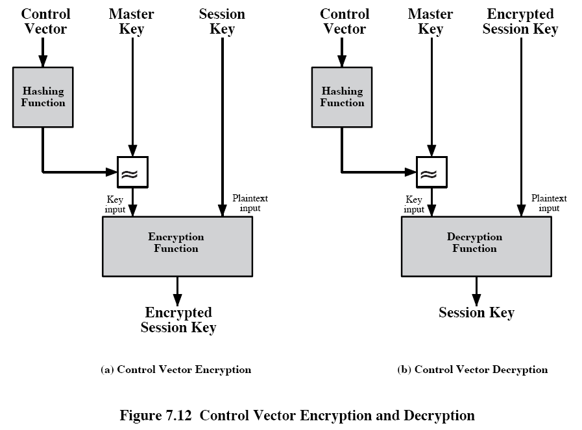

Controlling Key Usage
Ciphertext
input

Slide 49
Controlling Key Usage
Two advantages of using the control vector
  No restriction on length of the control vector
  The control vector is available at all stages of operation

Slide 50
Contents
Placement of Encryption Function
Traffic Confidentiality
Key Distribution
Random Number Generation

Slide 51
The Use of Random Numbers
The use of random numbers
  Nonces
  Session keys
  Prime number generation
Two requirements for random numbers
  Randomness
  Unpredictability

Slide 52
The Use of Random Numbers
Randomness
  Uniform distribution
    The distribution of numbers in the sequence should be uniform.
    That is, the frequency of occurrence of each of the numbers should be approximately the same.
  Independence
    No one value in the sequence can be inferred from the others.

Slide 53
The Use of Random Numbers
Randomness
  Although there are well-defined tests for determining that a sequence of numbers is a uniform distribution, there is no such test to “prove” independence.
  Rather, a number of tests can be applied to demonstrate if a sequence does not exhibit independence.
  The general strategy is to apply a number of such tests until the confidence that independence exists is sufficiently strong.

Slide 54
The Use of Random Numbers
Unpredictability
  Unpredictability is that it is impossible to predict future elements of the sequence on the basis of earlier elements.
  Unpredictability is weaker condition than Randomness
    Because with random sequences, each number is statistically independent of other numbers in the sequence and therefore unpredictable.
  In some applications, the sequence of numbers is not required to be statistically random but the successive numbers should be unpredictable.

Slide 55
PRNG
Pseudorandom number generators (PRNGs)
  Cryptographic applications typically make use of algorithmic techniques for random number generation.
  The numbers generated in this way are not ‘true’ random numbers because the algorithm used for generation is deterministic.
  However, if the numbers pass many reasonable tests of randomness, the numbers are called pseudorandom numbers.
  Moreover, the algorithm used for generation is called pseudorandom number generator.

Slide 56
PRNG
Pseudorandom Number Generators (PRNGs)
  Linear congruential generators
  Cryptographically generated random numbers.
    Cyclic encryption
    ANSI X9.17 PRNG
    Blum Blum Shub Generator

Slide 57
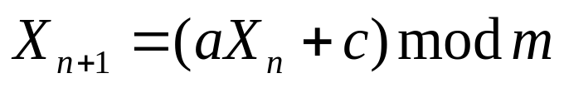
Linear Congruential Generators
X₁X_{2 …} X_{n} : the sequence of random numbers
m | the modulus | m > 0
a | the multiplier | 0 < a < m
c | the increment | 0 ≤ c < m
X₀ | the starting value, or seed | 0 ≤ X₀ < m

Slide 58
Linear Congruential Generators
Parameters a and c should be carefully chosen.
  a = c = 1
    X_{n+1} = (X_{n}+1) mod m
  a = 7, c = 0, m = 32, X₀ = 1
    X_{n+1} = (7X_{n}+ 0) mod 32
    {7, 17, 23, 1, 7, 17…}: a period of 4
  a = 5, c = 0, m = 32, X₀ = 1
    X_{n+1} = (5X_{n}+ 0) mod 32
    {X_{n}} = {5, 25, 29, 17, 21, 9, 13, 1, 5,…}: a period of 8

Slide 59
Linear Congruential Generators
m should be very large.
  If m is large there is the potential for producing a long series of distinct random numbers.
  A common criterion is that m be nearly equal to the maximum integer that can be represented by a given computer.
    If the length of an integer is 4-byte, an integer around 2³¹ is chosen.

Slide 60
Linear Congruential Generators
Three tests in evaluating a random number generator by [PARK88].
  T₁: The function should be a full-period generating function.
    It should generate all the numbers between 0 and m before repeating.
  T₂: The generated sequence should appear random.
    The sequence should pass some statistical tests.
  T₃: The function should implement efficiently with 32-bit arithmetic.

Slide 61
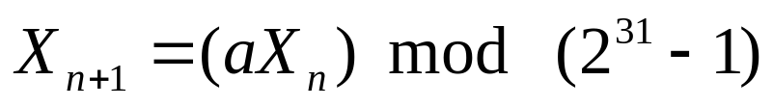
Linear Congruential Generators
With respect to T₁, it can be shown that if m is prime and c = 0, then for some values of a, the period of the generating function is m – 1 (0 is missing).
For 32-bit arithmetic, a convenient prime value of m is 2³¹-1.
More than 2 billion possible choices for a, only a handful of multipliers pass all three tests. One such value is a = 7⁵ = 16807.

Slide 62
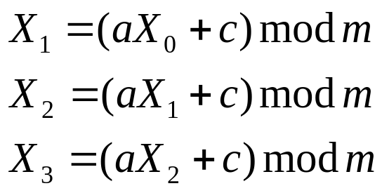
Linear Congruential Generators
Cryptanalysis for the linear congruential method.
  If an opponent knows that the linear congruential algorithm is being used and knows the parameter values (e.g., a = 7⁵, c = 0, m = 2³¹-1), then once he knows a single number X_{n}, all subsequent numbers are known.
  Even if the opponent does not know the parameter values, he can find a, c, and m if he sees X₀, X₁, X₂ and X₃ .

Slide 63
Linear Congruential Generators
So although a good PRNG is used, it is desirable to make the sequence nonreproducible.
  Restart the sequence after every N numbers using the current clock value as the new seed.
  Add the current clock value to each random number (mod m).

Slide 64
Cryptographically Generated Random Numbers
We use the encryption logic to produce random number.
Three representative examples
  Cyclic encryption
  DES output feedback mode
  ANSI X9.17 PRNG

Slide 65
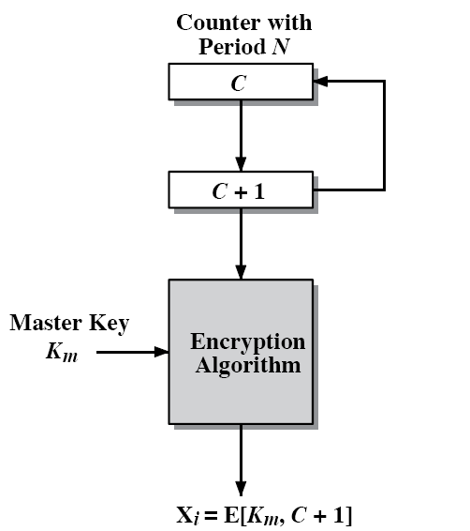
Cryptographically Generated Random Numbers
Cyclic Encryption
  It generate session keys from a master key.
  A counter with period N provides input to the encryption logic.
    If 56-bit DES keys are to be produced, then a counter with period 2⁵⁶ can be used.
    After each key is produced, the counter is incremented by one.

Slide 66
Cryptographically Generated Random Numbers
Cyclic Encryption
  The pseudorandom numbers produced by this scheme cycle through a full period.
    Each of the outputs X₀, X₁, … , X_{N-1} is based on a different counter value and therefore X₀ ≠ X₁ ≠ … ≠ X_{N-1}.

Slide 67
Cryptographically Generated Random Numbers
Cyclic Encryption
  It is not computationally feasible to deduce any of the session keys through knowledge of one or more earlier session keys.
    If this is possible, it means the encryption algorithm is broken in the same way.
    So if the encryption algorithm is safe, the session keys cannot be deduced.

Slide 68
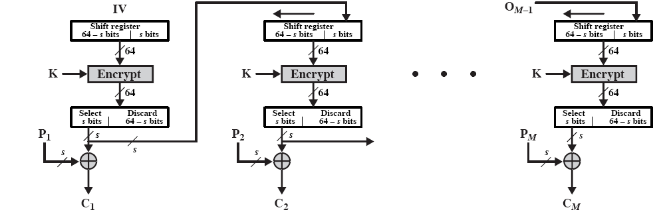
Cryptographically Generated Random Numbers
DES output feedback mode

Slide 69
Cryptographically Generated Random Numbers
ANSI X9.17 PRNG
  It consists of iterations where each iteration uses triple DES.
  The i^{th} iteration
    Input: Two 64-bit pseudorandom numbers
      DT_{i}: Current date and time
      V_{i}: A seed generated in the previous iteration
    Output: Two 64-bit pseudorandom numbers
      R_{i} : Pseudorandom number
      V_{i+1} : The seed for the next iteration

Slide 70
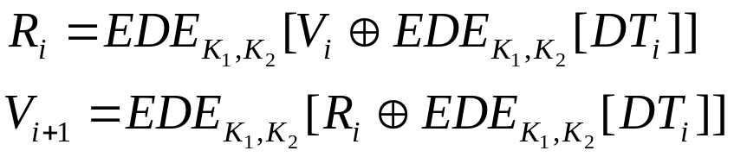
Cryptographically Generated Random Numbers
K₁, K₂ : Two 56-bit DES keys
Even if R_{i}, R_{i+1}… R_{i+j} is known, it is difficult to deduce R_{i+j+1} because DT_{i+j} and V_{i+j} are unknown.

Slide 71
Cryptographically Generated Random Numbers
Blum Blum Shub Generator
  A popular approach to generating secure pseudorandom number is known as the Blum, Blum, Shub (BBS) generator.
  It has perhaps the strongest public proof of its cryptographic strength.

Slide 72

Cryptographically Generated Random Numbers
BBS Generator
  Choose two large prime numbers p and q that have a remainder of 3 when divided by 4.
  Let n = pq.
  Choose a random number s that is relatively prime to n.
  Produces a sequence of bits B_{i} according to he following algorithm.
X₀ = s² mod n for i = 1 to ∞ X_{i} = (X_{i-1})² mod n B_{i} = X_{i} mod 2

Slide 73
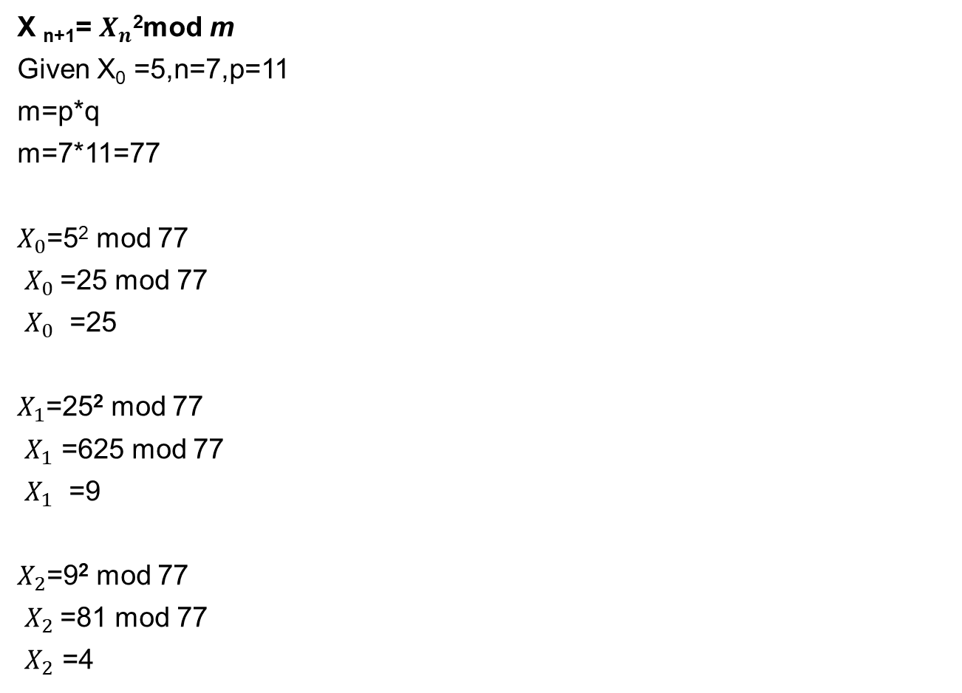
Example of BBS

Slide 74
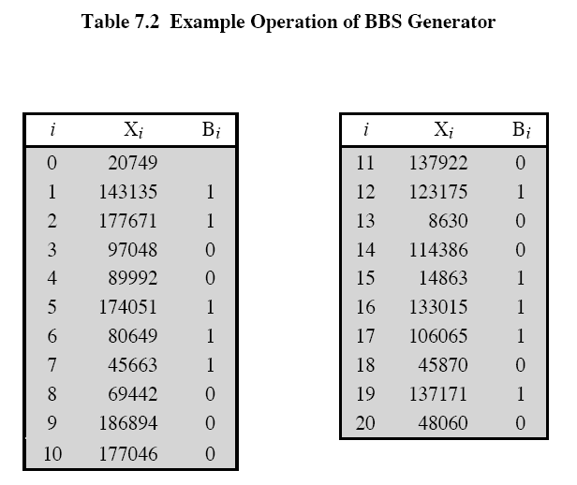
Cryptographically Generated Random Numbers
  The LSB of X_{i} is taken at each iteration.

Slide 75
Cryptographically Generated Random Numbers
  The BBS is referred to as a cryptographically secure pseudorandom bit generator (CSPRBG).
  A CSPRBG is defined as one that passed the next-bit-test.
  Next-bit-test
    A pseudorandom bit generator is said to pass the next-bit test
    if there is not a polynomial-time algorithm that can predict the (k+1)^{st} bit with probability significantly greater than ½ on input of the first k bits of an output sequence.
    That is, given the first k bits of the sequence, there is not a practical algorithm that can even allow you to state that the next bit will be 1 or 0 with probability greater than ½ (unpredictable).

Slide 76
Cryptographically Generated Random Numbers
The security of BBS is based on the difficulty of factoring n when n = pq for .
  Because it is proved that if one can predict the next bit in BBS generator, one can factor n, which is already known to be a hard problem.

Slide 77
True Random Number Generators
True Random Number Generators
  A true random number generator (TRNG) uses a nondeterministic source to produce randomness.
  Software processes the result into truly random numbers in a variety of formats.
  There are problems both with the randomness and the precision of such numbers.

Slide 78
True Random Number Generators
True Random Number Generators (Cont’)
  A collection of good-quality random numbers that have been published.
  But, these collections provide a very limited source of numbers.
  Furthermore, they are predictable because an opponent who knows that the book is in use can obtain a copy.

Slide 79
Random Number Generation
Skew

